Slide 1

Permutation & Combination
Placement Preparation
Aptitude & Reasoning
Prof. Krunal D. Vyas
Computer Engineering Department
krunal.vyas@darshan.ac.in
9601901005

Slide 2
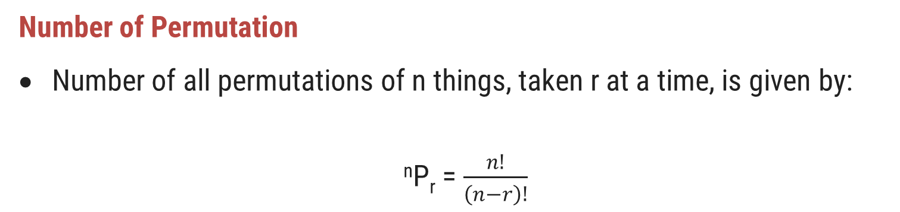
Permutation
The different arrangements of a given number or things by taking some or all at a time, are called permutation.
For example, all permutations made with the letters of ‘abc’, taking two at a time are: ab, ba, ac, ca, bc, cb and all permutations made with the letters of ‘abc’, taking all at a time are: abc, acb, bac, bca, cab, cba.
Number of Permutation
Number of all permutations of n things, taken r at a time, is given by:
^{n}P_{r} = $\frac{n!}{\left(n−r\right)!}$

Slide 3
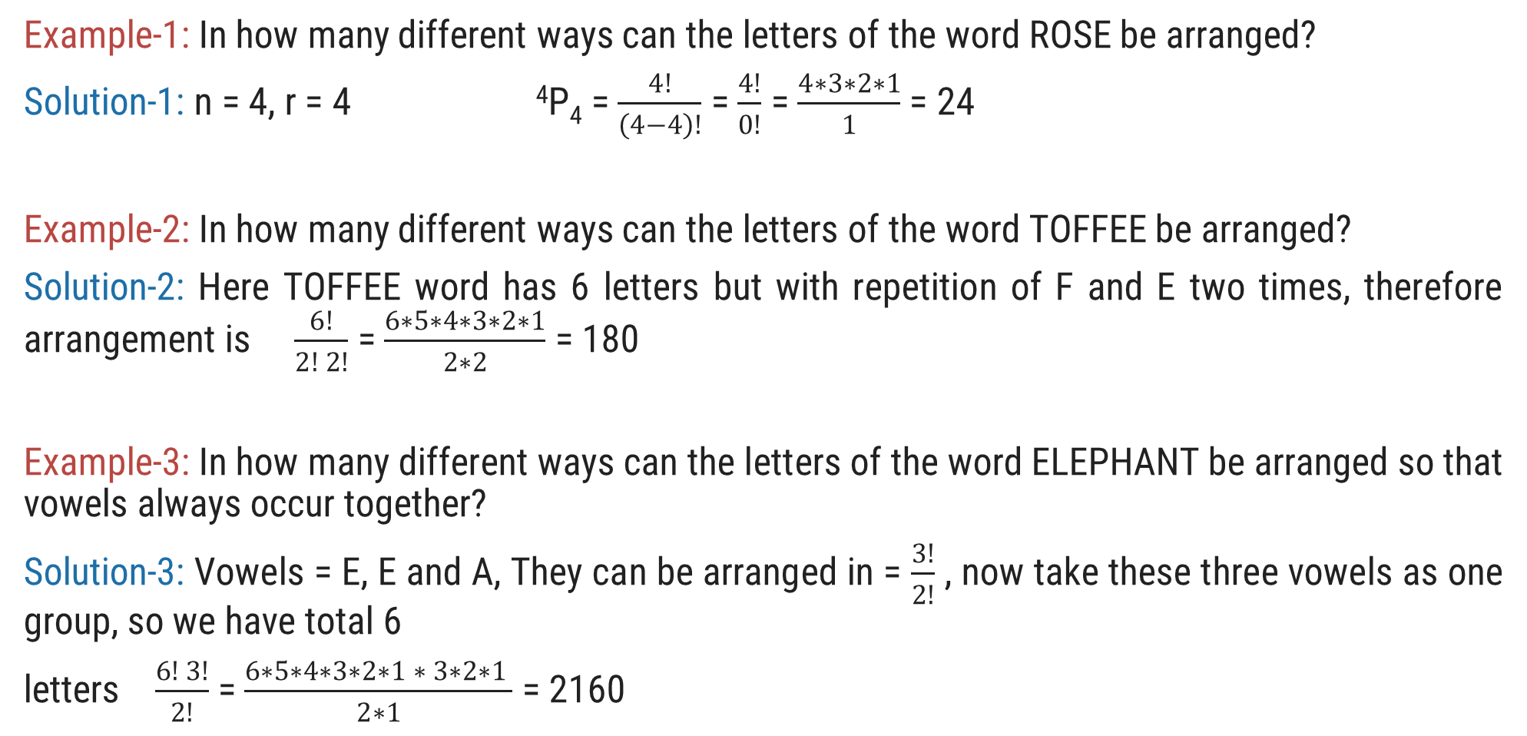
Permutation Examples
Example-1: In how many different ways can the letters of the word ROSE be arranged?
Solution-1: n = 4, r = 4 ⁴P₄ = $\frac{4!}{\left(4−4\right)!}$ = $\frac{4!}{0!}$ = $\frac{4∗3∗2∗1}{1}$ = 24
Example-2: In how many different ways can the letters of the word TOFFEE be arranged?
Solution-2: Here TOFFEE word has 6 letters but with repetition of F and E two times, therefore arrangement is $\frac{6!}{2! 2!}$ = $\frac{6∗5∗4∗3∗2∗1}{2∗2}$ = 180
Example-3: In how many different ways can the letters of the word ELEPHANT be arranged so that vowels always occur together?
Solution-3: Vowels = E, E and A, They can be arranged in = $\frac{3!}{2!}$ , now take these three vowels as one group, so we have total 6
letters $\frac{6! 3!}{2!}$ = $\frac{6∗5∗4∗3∗2∗1 ∗ 3∗2∗1 }{2∗1}$ = 2160

Slide 4
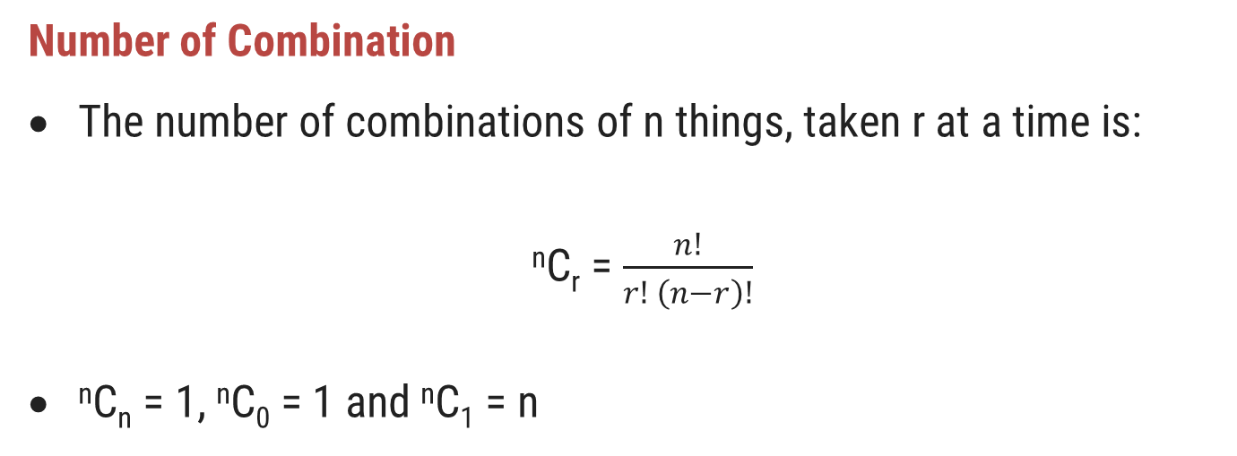
Combination
Combination means selection, committee, group
Each of the different groups or selections which can be formed by taking some or all of a number of objects called a combination.
For example, if we want to select two out of three persons A, B, and C, then possible selections are: AB, BC and CA. (Note here that AB and BA represent the same selection)
Number of Combination
The number of combinations of n things, taken r at a time is:
^{n}C_{r} = $\frac{n!}{r! \left(n−r\right)!}$
^{n}C_{n} = 1, ^{n}C₀ = 1 and ^{n}C₁ = n

Slide 5
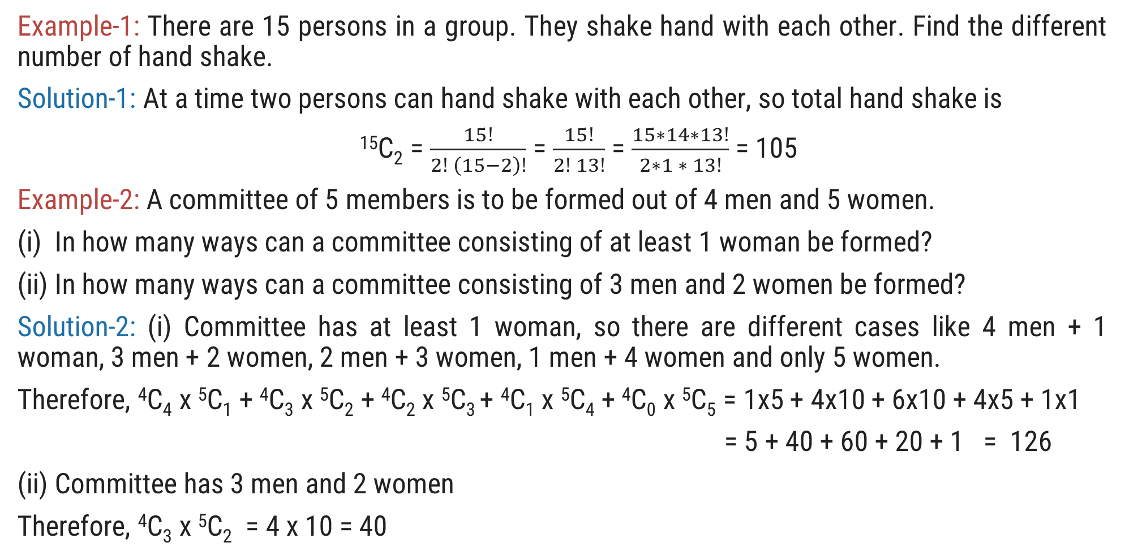
Combination Examples
Example-1: There are 15 persons in a group. They shake hand with each other. Find the different number of hand shake.
Solution-1: At a time two persons can hand shake with each other, so total hand shake is
¹⁵C₂ = $\frac{15!}{2! \left(15−2\right)!}$ = $\frac{15!}{2! 13!}$ = $\frac{15∗14∗13!}{2∗1 ∗ 13!}$ = 105
Example-2: A committee of 5 members is to be formed out of 4 men and 5 women.
(i) In how many ways can a committee consisting of at least 1 woman be formed?
(ii) In how many ways can a committee consisting of 3 men and 2 women be formed?
Solution-2: (i) Committee has at least 1 woman, so there are different cases like 4 men + 1 woman, 3 men + 2 women, 2 men + 3 women, 1 men + 4 women and only 5 women.
Therefore, ⁴C₄ x ⁵C₁ + ⁴C₃ x ⁵C₂ + ⁴C₂ x ⁵C₃ + ⁴C₁ x ⁵C₄ + ⁴C₀ x ⁵C₅ = 1x5 + 4x10 + 6x10 + 4x5 + 1x1
= 5 + 40 + 60 + 20 + 1 = 126
(ii) Committee has 3 men and 2 women
Therefore, ⁴C₃ x ⁵C₂ = 4 x 10 = 40

Slide 6
Exercise
Ex-1: In how many different ways can the letters of the word AUCTION be arranged so that vowels always occur together?
Ex-2: In how many different ways can the letters of the word ALLAHABAD be arranged?
Ex-3: Out of 5 women and 4 men, a committee of three members is to be formed in such a way that at least one member is a woman. In how many different ways can it be done?
Ex-4: In how many different ways can the letters of the word MACHINE be arranged so that vowels may occupy only the odd positions?
Ex-5: A committee of 5 members is to be formed out of 3 trainees, 4 professors, and 6 research associates. In how many different ways can this be done if the committee should have 2 trainees and 3 research associates?
Ans = 576
Ans = 7560
Ans = 80
Ans = 576
Ans = 60

